Slide 1
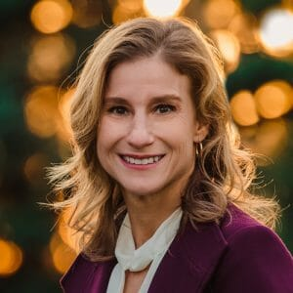
Title IX Evidence Collection:
Strategies to Ensure a Complete Investigation
Cara Hardin, J.D.
Title IX Deputy Coordinator
Marquette University
cara.hardin@marquette.edu
May 11, 2021

Slide 2

Zoom Features
Mics (keep muted please)
Camera (option to keep on or off)
Chat Box
  Use to ask questions or respond
  Send Rabia a private message for anonymous questions
  To find downloadable files during the presentation
  To send private messages to each other or host
Recording (available 10 days from today)
Participant List with Emoji’s
  Change Name: First Name, Last Name Initial, Insititution
    Hover over your name, select “more” then “rename”

Slide 3
After participating, you will be able to effectively and thoroughly identify all the available evidence necessary for the decision-maker to determine responsibility.

Slide 4
Part 1: Setting the Stage
Part 2: Testimonial Evidence: Building Rapport and Asking the Right Questions
Break
Part 3: Identifying and Collecting Physical Evidence
Final Q&A and Close

Slide 5
Part 1: Setting the Stage

Slide 6

Types of Evidence: Testimonial
Testimonial Evidence comes in a variety of forms:
  Investigator interviews with:
    Parties
    Witnesses
    Expert witnesses
  Statements (assertions of fact) made in other medium:
    Electronic communications (texts, emails, chats)
    Police reports
    SANE reports
      106.45(b)(1)(x): Need signed waiver to obtain and include in Investigative File

Slide 8
Types of Evidence: Non-Testimonial
Non-testimonial evidence
  Documents
  Photographs
  Video
  SANE reports

Slide 10
An Essential Tool: Building a Timeline
Building a timeline surrounding the alleged incident:
  Exposes the gaps in the investigation
  Documents the movement of the parties and witnesses
  Helps identify inconsistencies or serves to corroborate
  Validates or refutes alibis

Slide 11
Timeline: How-To
Where to look to build your timeline:
  Timestamps within electronic communications

Slide 12
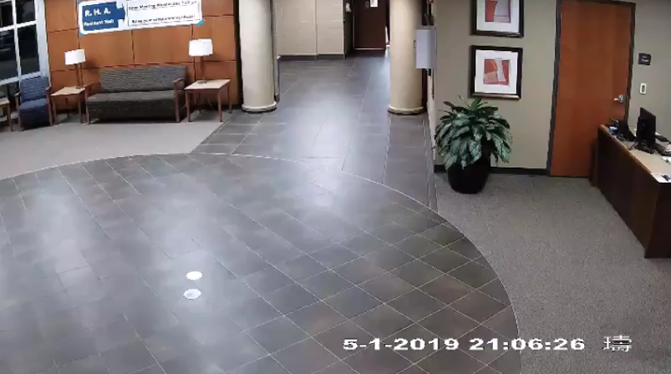
Timeline: How-To (cont.)
Where to look to build your timeline:
  Timestamps within video surveillance

Slide 13
Timeline: How-To (cont.)
Where to look to build your timeline:
Hospital records
Receipts
911 dispatch records/calls

Slide 14
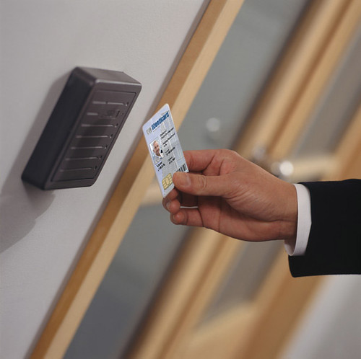
Building Your Timeline: How-To
Where to look to build your timeline:
  University access records

Slide 16
Small Group Activity
Scenario #1
Practicing with a Timeline

Slide 17
Part 2: Testimonial Evidence Building Rapport and Asking the Right Questions

Slide 18
Party/Witness Interviews
Party/witness interviews:
  Building rapport
  Effective questioning

Slide 19
Gathering Evidence: Building Rapport
  Building rapport
    Identify mutual interests or commonalities between the investigator and the interviewee
    Attentive
    Transparent about the investigation process and the investigator’s role within it
    Provide control
    Answer questions

Slide 20
Demo
“Rapport building”

Slide 21
Effective Questioning
Effective questioning
  Seeking a narrative
  Closed v. Open-Ended Questions
  The Funnel Method
  Questioning Pitfalls

Slide 22
Closed v. Open-Ended Questions
Closed Questions
Open-Ended Questions
You went to the party with the Complainant and your roommate
Who went with you to the party?
You said “no” when the Respondent kissed you.
How did you respond when the Respondent kissed you?
After you said “no,” you shoved the Respondent to the ground
What happened next?

Slide 23
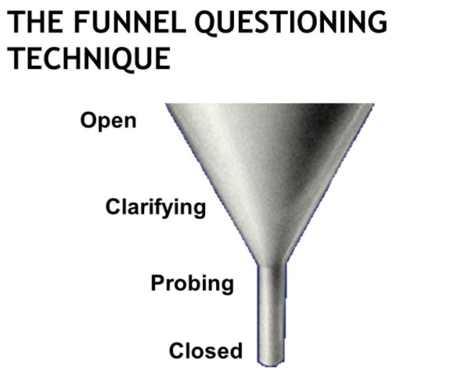
The Funnel Method
…… open-ended questions to solicit information
…… to clarify and narrow focus
Listen
…… to solicit additional detail
Exhaust
….. anything else?
…… to clarify or commit
CHECK
…… you’re understood

Slide 24
Open-Ended Questions
Open-ended questions allows the interviewee to “fill the space”
Begin by asking broad questions like…
  Q: “Tell me about your evening the night of August 22…”
  Q: “Please walk me through your time at the fraternity party….”
Start narrowing the questioning based on what you learned
  Q: “Tell me more about…”
  Q: “Please explain further how….”

Slide 25
Effective Questioning (cont.)
The importance of transitions
  Q: “I want to take you back to the part where you
  talked about….”
  Q: “Let’s focus on your conversation with your
  roommate after you got home…”
Notes:
Helps refocus after diarrhea of the mouth…

Slide 26
Effective Questioning
Demo
Small group critique

Slide 28
Effective Questioning: Pitfalls 1-2
  Asking open-ended questions in a leading/closed manner.
    “Did you go to the police right after you left Respondent’s apartment?”
    “Were you scared when your partner’s hands were around your neck?”
  Asking compound questions
    “Describe what you saw, what you heard, and what you did?”
    One question at a time: “What did you see?”
    “What did you hear?”
    “What did you do?”

Slide 29
Effective Questioning: Pitfalls 3-5
  3. Failing to clarify complex answers.
    “Tell me if I understand you correctly, you said…”
    “I am not sure that I understand, what does that mean?”
  4. Assuming you know what the witness means.
    “I talked to Jane last night.”
  5. Assumptions about what happened, generally.

Slide 30
Effective Questioning: Pitfalls 6-8
  6. Failing to use understandable (“normal”) language.
    “Are you and Jane intimate with one another?”
    “Did your fingers penetrate Jane’s labia majora?”
  7. Interrupting the witness.
  8. Harmful spoken or body language in response to
  answers to questions.

Slide 31
Stumped: Refreshing Recollection
  “I don’t know” v. “I don’t remember”
  “I don’t know” – Person never knew
  “I don’t remember” – Person did know at one time.
    Helping the person remember:
          Texts
          Video
          Photos
          Going to the scene

Slide 32
Effective Questioning: Benefits of Trauma Informed Interviewing
Trauma-informed interviewing techniques are helpful with any party or witness, not just complainants.
Result is to obtain better information and to have the interviewee leave the interview feeling respected rather than victimized by the interview experience.

Slide 33
Effective Questioning: Trauma (Part 1)
  Trauma-informed interviewing techniques.
  (Back to the beginning): Rapport building
      Acknowledge difficult situation
      Explaining that you may ask personal questions
      No judgements will be made
      There is no wrong answer
  Provide control to the party or witness (opportunity to take a break, asking where they would like to begin, etc.)
  Using a conversational approach rather than rapid fire questioning

Slide 34
Effective Questioning: Trauma (cont.)
Trauma-informed interviewing techniques.
  Be cognizant of “sensory” responses: sight, sound, smell, etc.
  Avoid victim-blaming and rape-myths during questioning
    Both practices can function to re-victimize or cause trauma/blame/shame
    Explain reasoning behind difficult questions

Slide 36
Part 3: Identifying and Collecting Physical Evidence

Slide 37
Physical Evidence
How physical evidence can be critical to your case:
The text message that the Respondent allegedly sent to the Complainant’s roommate admitting to the misconduct.
The medical report noting the injury that the Complainant claims to have sustained during the alleged misconduct.
Campus building access report that shows the Complainant was not in the library on the date and time of the alleged misconduct.

Slide 38
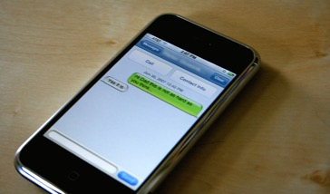

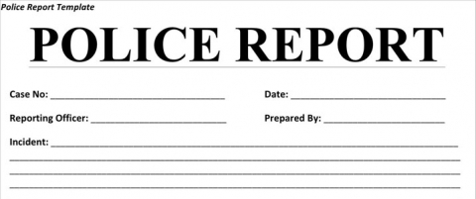
Physical Evidence: Where to Find It
Parties/Witnesses
    Campus access card records and video surveillance camera footage.
Documents from third-party sources

Slide 39
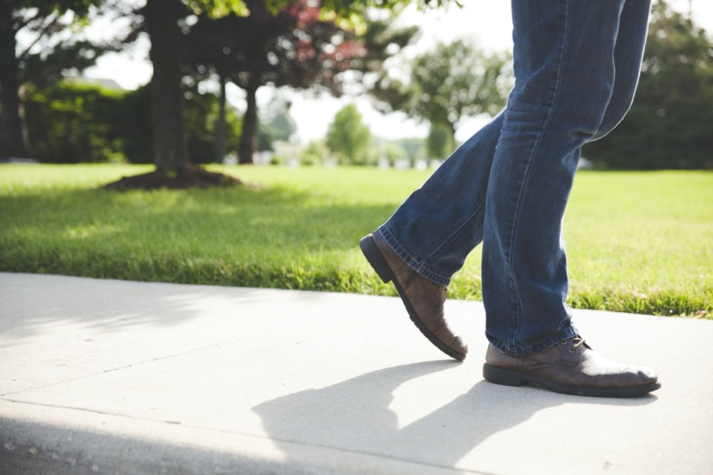
Physical Evidence: Where to Find It (cont.)
    Boots on the ground!

Slide 40
Small group activity
Scenario #2
What evidence may be available and where can you obtain it?

Slide 41
Building rapport and effective questioning during interviews increases the quality and quantity of the information the interviewee will provide.
Identifying and obtaining physical evidence helps to fill gaps in testimony, provides a basis to assess credibility, may corroborate or refute the allegations, and can provide additional insight over what may have occurred during and surrounding the alleged incident.
Creating a timeline is an essential tool for evidence-gathering.

